Slide 1


Updates
Olivier Bergeron
13/03/2026

Slide 2

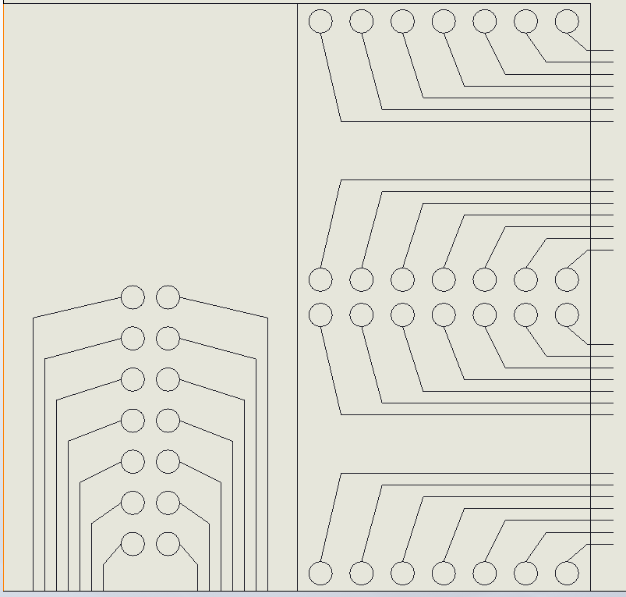
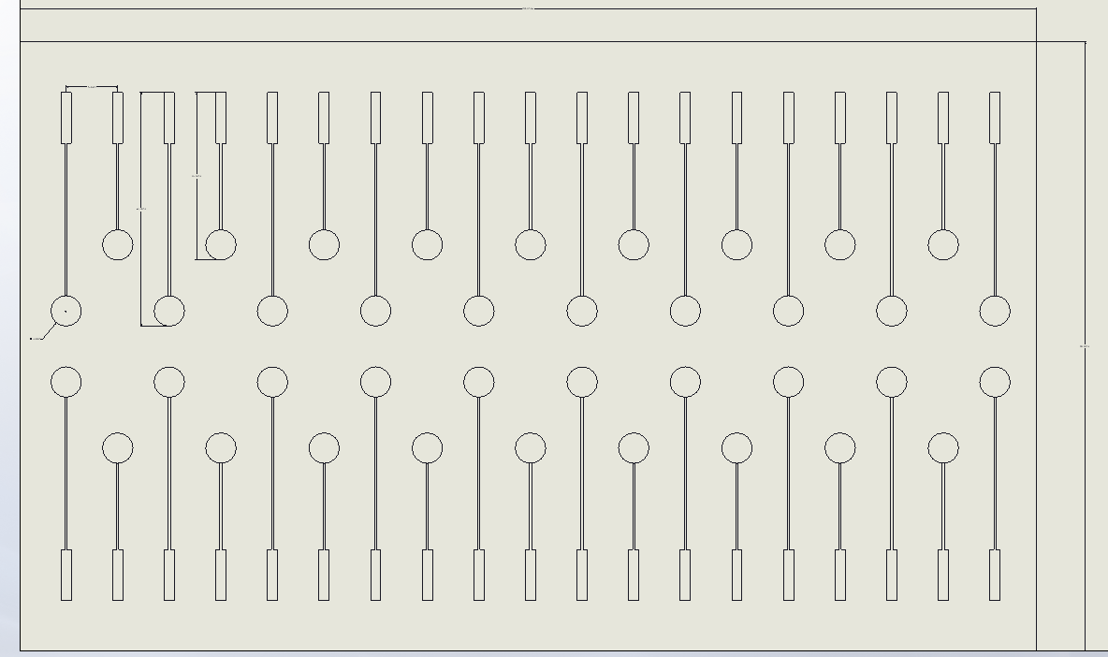
Follow ups with Ankur (ETS)
Couple calls with Ankur about a new design
Small miscommunication issues
Still asking for its process limitation
Working on a design for the Main project

Slide 3
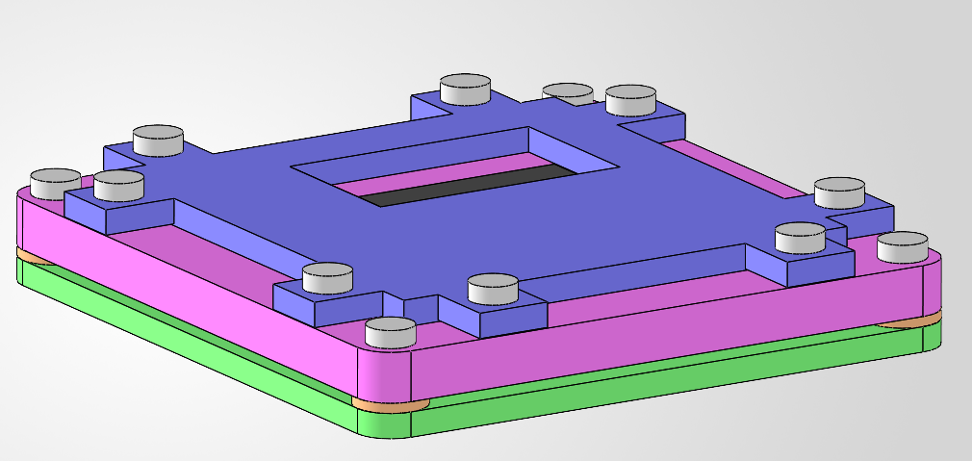
Impedance test bench
128.5 mm
135.5 mm
22.2 mm

Slide 4
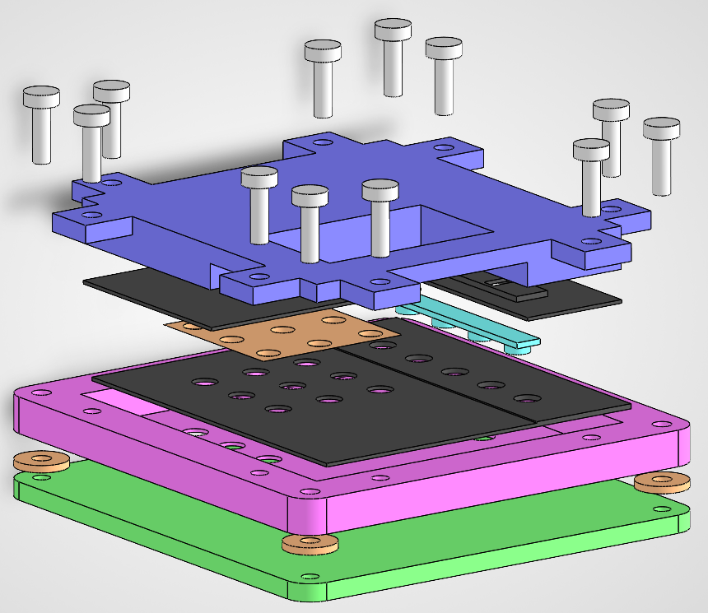
TPU
PETG

Slide 5






Impedance test bench
`
OUT
CURRENT
HI
V1
LO
Solartron 1260

Slide 6
Impedance test bench
Order material (BOM ready)
Print parts
Prepare setup
Test

Slide 7
Process analysis
Preparing an analysis for Benoit: WIP
Electrode process: Done
Flexible circuit: Almost done
Electronic connection: Started
Main goal while waiting for impedance test setup

Slide 8
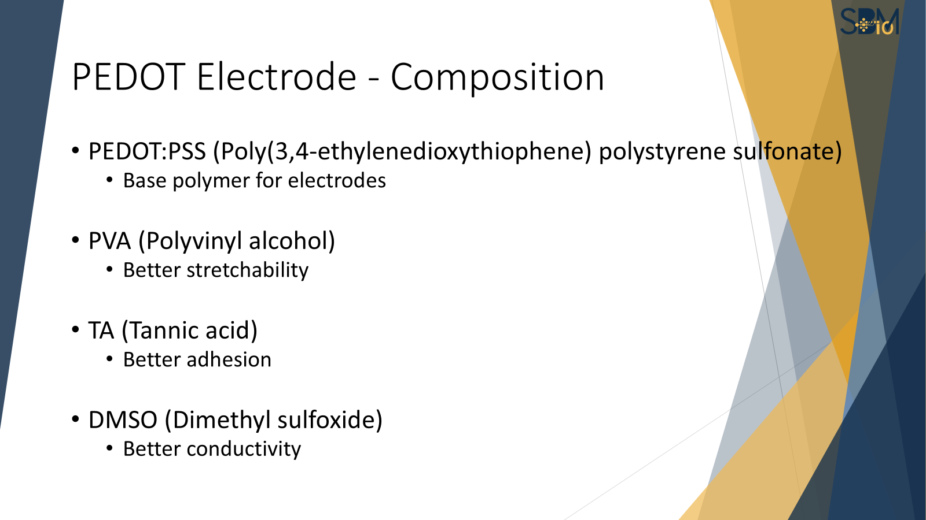
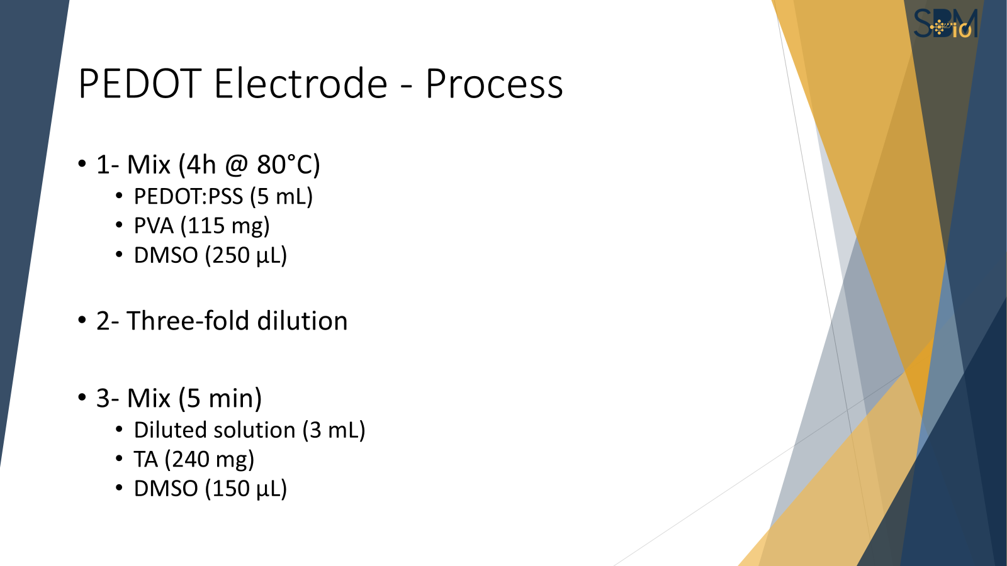
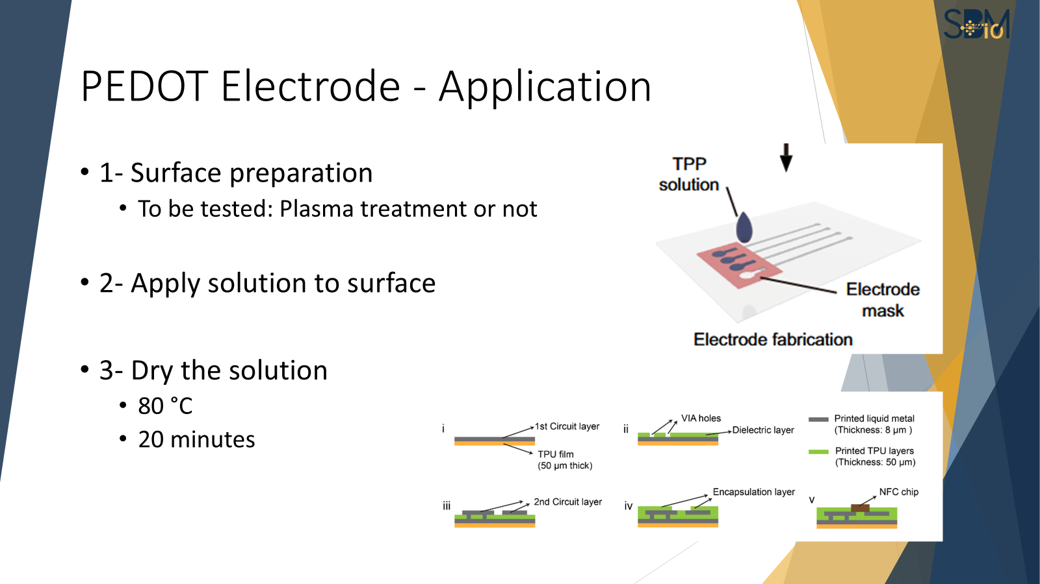
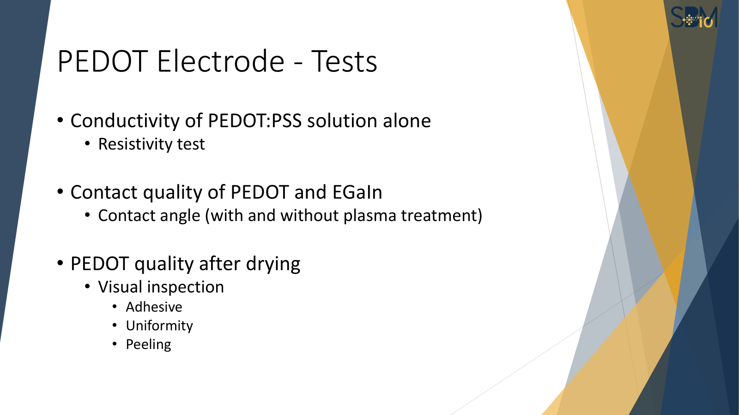
Process analysis
Little preview

